Slide 1
Computer Architecture project
4- bit ALU Design & Implementation
Project Members:-
Ahmed Sayed Ahmed (8)
Ahmed Alaa Elden Yousef (13)
Hosny Mohamad Salem (42)
4. Shehata Abd ALmohsen (50)
Under Supervision of:-
Prof. Dr: Khaled El Shafeay

Slide 2
• Objective:
Implementing a 4-bit ALU that performs the following functions:
1. Add.
2. Subtract.
3. Increment.
4. Decrement.
5. Transfer.
6. Bitwise AND.
7. Bitwise OR.
8. Bitwise XOR.
9. Bitwise NOT.

Slide 3
Features:
The ALU has 2 input operands A and B, 4 bit each (in Operations such as Increment, Decrement, Transfer, Bitwise Not, Operand B is neglected, and the operation will be performed on Operand A).
It has 4 input pins (S2, S1, S0, Cin) to select the operation that will be performed by the ALU. o S2 determines whether the operation to be performed is Arithmetic or Logic Operation. 0 for Arithmetic, 1 for Logic. o If S2 is 1, Cin will be neglected.
The output consists of 4 bits (G3, G2, G1, G0) in addition to the Carry out pin (Cout). 3 Flags are included in the design:
1. Z (Zero Flag) is set if the output of an arithmetic or logic operation is zero.
2. V (Overflow Flag) is set when overflow occurs within an arithmetic operation is performed.
3. N (Negative Flag) is set if the output of an arithmetic operation is negative.
Tools:
The implementation and simulated on Protues.

Slide 4
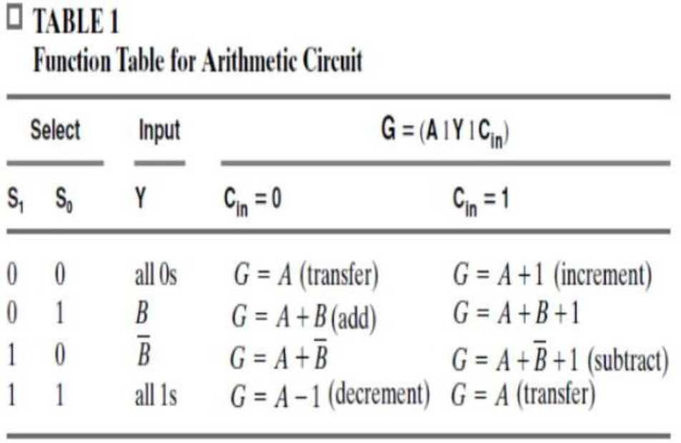
Function Table
If S2 = 0, the ALU performs Arithmetic operation according to the following table:

Slide 5
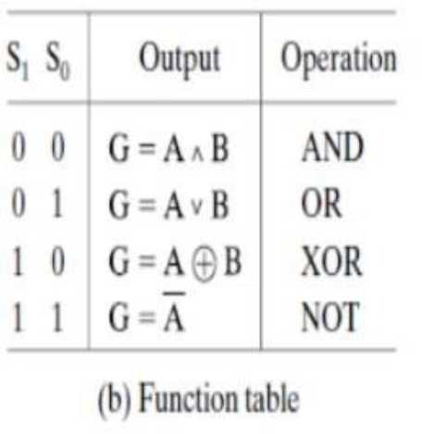
If S2 = 1, the ALU performs Logical operation according to the following table:

Slide 6
0
0
1
0
ALU
A0
A1
A2
A3
G0
?
0
1
1
0
G1
?
?
B0
G2
?
B1
B2
G3
B3
Cout
?
0
V
 | ?
 | ?
 | ?
N
Cin
Z
1
0
0
S0
S1
S2
CCT010

Slide 7
Logic Diagram of the 4bit ALU
A0
4BIT BINARRY ADDER
B_INPUT_LOGIC
A1
A0
A2
A1
S0
MUX
B0
B0
A3
A2
S1
B1
B1
A3
S2
A0
Y0
S3
A1
B2
B2
B0
4_{B}-₁Bit Binnary Adder
B2
A2
B3
B3
Y1
A3
D0
G0
Y2
B3
Adder_Cout
D1
G1
A0
A0
Cout
B0
D2
G2
A1
A1
Y3
N
Adder_N
4Bit 2 to 1 MUX _{D3}
B1
G3
A2
A2
S0
S0
Cin
Cin
V
Adder_V
B2
A3
A3
S1
S1
CCT004
LOGIC_UNIT
B3
CCT006
A0
A0
B0
B0
A1
A1
S2
S
B1
B1
A2
A2
CCT007
B2
B2
A3
A3
G0
G0
G0
G1
G1
B3
B3
B0
B0
G1
G2
G2
B1
B1
G2
G3
G3
B2
B2
Cin
Cin
B3
B3
G3
Adder_Cout
U17
U16
Cout
S0
S0
S0
S0
S2
NOT
AND
S1
S1
S1
S1
G0 G1 G2
2 ^{U13:A}
CCT015
3
1
U14
Z
S2
S2
4
5
NOT
G3
74HC4072
Adder_N
U18
U20
N
S2
AND
NOT
U19
Adder_V
V
AND

Slide 8
Logic Diagram of the 4bit Binarry Adder
with Flags
FA0
X
S
Y
FULL_ADDER
S0
A0
C
A1
Z
S1
A2
CCT003
A3
FA1
S2
X
S
Y
FULL_ADDER
S3
B0
C
B1
Z
B2
CCT003
B3
FA2
Cin
X
Cout
S
Y
FULL_ADDER
Z
C
CCT003
U15
FA3
V
X
XOR
S
Y
FULL_ADDER
N
Z
C
CCT003

Slide 9
Design of the FULL ADDER
HA1
X
X
S
HA2
HALF_ADDER
X
S
S
Y
Y
C
HALF_ADDER
CCT001
Y
C
CCT001
U63
C
Z
OR

Slide 10
Design of the HALF ADDER
X
U141
S
XOR
U142
Y
C
AND

Slide 11
B_INPUT_LOGIC_BIT0
B
B0
Select_0
S0
Y
Y0
B1
Select_1
S1
Logic Diagram of the 4bit Combinational
B2
CCT008
B3
B_INPUT_LOGIC_BIT1
B
circuit that applied
on operand B
Select_0
S0
Y
Y1
Select_0
Select_1
S1
S0
Select_1
CCT009
S1
B_INPUT_LOGIC_BIT2
B
Select_0
S0
Y
Select_1
S1
Y2
CCT011
B_INPUT_LOGIC_BIT3
B
Select_0
S0
Y
Y3
S1

Slide 12
B
U83
U86
NOT
AND
U85
S0
U84
Y
S1
OR
AND
Design of Each bit of the combinational circuit that is applied on Operand B

Slide 13
A0
A0_INPUT
A1
A1_INPUT
A2
A2_INPUT
AND_CHIP
XOR_CHIP
A3
A3_INPUT
A0_INPUT
A0
A0_INPUT
A0
B0
B0_INPUT
A1_INPUT
A1
A1_INPUT
A1
B1
B1_INPUT
A2_INPUT
A2
G0
AND_G0
A2_INPUT
A2
G0
XOR_G0
B2
B2_INPUT
A3_INPUT
A3
G1
AND_G1
A3_INPUT
A3
G1
XOR_G1
B3
B3_INPUT
G2
AND_G2
G2
XOR_G2
4X1_4BIT_MUX
B0_INPUT
B0
G3
AND_G3
G3
XOR_G3
AND_G0
AND_G0
B1_INPUT
B1
B0_INPUT
B0
AND_G1
AND_G1
B2_INPUT
B2
B1_INPUT
B1
AND_G2
AND_G2
B3_INPUT
B3
B2_INPUT
B2
AND_G3
AND_G3
S0
Selector_0
CCT016
B3_INPUT
B3
S1
Selector_1
CCT018
OR_G0
OR_G0
OR_G1
OR_G1
OR_CHIP
NOT_CHIP
OR_G2
OR_G2
A0_INPUT
A0
A0_INPUT
A0
OR_G3
OR_G3
G0
G0
A1_INPUT
A1
A1_INPUT
A1
XOR_G0
XOR_G0
G1
G1
A2_INPUT
A2
G0
OR_G0
A2_INPUT
A2
XOR_G1
XOR_G1
G2
G2
A3_INPUT
A3
G1
OR_G1
A3_INPUT
A3
G0
NOT_G0
XOR_G2
XOR_G2
G3
G3
G2
OR_G2
G1
NOT_G1
XOR_G3
XOR_G3
G3
OR_G3
G2
NOT_G2
B0_INPUT
B0 B1
G3
NOT_G3
B1_INPUT
NOT_G0
NOT_G0
B2_INPUT
B2
NOT_G1
NOT_G1
B3_INPUT
B3
CCT019
NOT_G2
NOT_G2
CCT017
NOT_G3
NOT_G3
Design of the Logic Unit
Selector_0
S0
Selector_1
S1
CCT023
 | ?
 | 0
 | ?
 | ?
 | 0 ?
 | 0
 | 0
 | 0
AND_G0
OR_G0
XOR_G0
NOT_G0
 | 0
 | 1
 | 0
AND_G1
OR_G1
XOR_G1
NOT_G1
AND_G2
OR_G2
XOR_G2
NOT_G2
AND_G3
0
OR_G3
?
XOR_G3
?
NOT_G3
1

Slide 14
Design of the 4-bit AND Function
U99
A0
G0
B0
AND
U100
A1
G1
B1
AND
U101
A2
G2
B2
AND
U102
A3
G3
B3
AND

Slide 15
Design of the 4-bit OR Function
A0
U103
B0
G0
OR
A1
U104
B1
G1
OR
A2
U105
B2
G2
OR
A3
U106
B3
G3
OR

Slide 16
Design of the 4-bit XOR Function
A0
U107
B0
G0
XOR
A1
U108
B1
G1
XOR
A2
U109
B2
G2
XOR
A3
U110
B3
G3
XOR

Slide 17
Design of the 4-bit NOT Function
U111
A0
NOT
U112
G0
A1
NOT
U113
G1
A2
NOT
U114
G2
A3
NOT
G3

Slide 18
Design of the 4-bit 4 to 1 MUX
S0
U115
SELECTOR_0
U118:A
SELECTOR_0 SELECTOR_1_INVERTED
OR_G0
1
SELECTOR_0_INVERTED
2
12
OR_G0O
NOT
13
7411
S1
U116
SELECTOR_1
SELECTOR_0 SELECTOR_1_INVERTED
OR_G1
3
4
U118:B
SELECTOR_1_INVERTED
5
6
OR_G1O
NOT
U122:A
7411
U120:C
₂ U123:A
SELECTOR_0_INVERTED SELECTOR_1_INVERTED
AND_G0
1
9
10
U118:C
9
10
AND_G0O OR_G0O
3
2
12
AND_G0O ^{SELECTOR_0} SELECTOR_1_INVERTED
OR_G2
8
SELECTOR_0 SELECTOR_1
NOT_G0
8
1
G0
AND_G0
AND_G0
13
OR_G2O
NOT_G0O
XOR_G0O NOT_G0O
4
AND_G1
AND_G1
7411
11
7411
U119:A
11
7411
5
74HC4072
AND_G2
AND_G2
1
2
U117:A
1
2
U121:A
₉ U123:B
AND_G3
AND_G3
SELECTOR_0_INVERTED SELECTOR_1_INVERTED
AND_G1
12
SELECTOR_0 AND_SGE1LOECTOR_1_INVERTED
OR_G3
12
OR_G3O
SELECTOR_0 SELECTOR_1
NOT_G1
1
AND_G1O OR_G1O
10
13
13
2
12
NOT_G1O
13
G1
7411
7411
13
XOR_G1O NOT_G1O
11
U117:B
7411
12
74HC4072
OR_G0
OR_G0
SELECTOR_0_INVERTED SELECTOR_1_INVERTED
AND_G2
3
U121:B
OR_G1
OR_G1
4
6
AND_G2O
U119:B
SELECTOR_0 SELECTOR_1
NOT_G2
3
AND_G2O OR_G2O
₂ U124:A
OR_G2
OR_G2
5
7411
U117:C
SELECTOR_0_INVERTED
SELECTOR_1
XOR_G0
3
4
5
6
NOT_G2O
3
1
G2
OR_G3
OR_G3
4
6
XOR_G0O
7411
U121:C
XOR_G2O NOT_G2O
4
SELECTOR_0_INVERTED SELECTOR_1_INVERTED
AND_G3
9
5
7411
5
74HC4072
XOR_G0
XOR_G0
10
8
AND_G3O
SELECTOR_0 SELECTOR_1
NOT_G3
9
10
XOR_G1
XOR_G1
11
7411
9
10
U119:C
11
8
NOT_G3O
AND_G3O OR_G3O
₉ U124:B
XOR_G2
XOR_G2
SELECTOR_0_INVERTED
SELECTOR_1
XOR_G1
11
8
XOR_G1O
7411
10
13
G3
XOR_G3O NOT_G3O
11
XOR_G3
XOR_G3
7411
12
74HC4072
NOT_G0
NOT_G0
SELECTOR_0_INVERTED
SELECTOR_1
XOR_G2
1
U120:A
NOT_G1
NOT_G1
2
12
XOR_G2O
NOT_G2
NOT_G2
13
7411
U120:B
NOT_G3
NOT_G3
SELECTOR_0_INVERTED
SELECTOR_1
XOR_G3
3
4
6
XOR_G3O
5
7411

Slide 19
MUX1
A0
A
B0
B
2to1 Mux ^{D}
D0
S
S
Internal design of the 4-bit 2 to 1 MUX
CCT005
MUX2
A1
A
B1
B
2to1 Mux ^{D}
D1
S
S
CCT005
MUX3
A2
A
B2
B
2to1 Mux ^{D}
D2
S
S
CCT005
MUX4
A3
A
B3
B
2to1 Mux ^{D}
D3
S
S
CCT005

Slide 20
Design of 1-bit 2 to 1 MUX
A
U9
U11
AND
U12
S
NOT
D
U10
OR
B
AND

Slide 21
0
0
1
0
ALU
A0
A1
A2
A3
G0
?
0
1
1
0
G1
?
?
B0
G2
?
B1
B2
G3
B3
Cout
?
0
V
 | ?
 | ?
 | ?
N
Cin
Z
1
0
0
S0
S1
S2
CCT010

Slide 22
Logic Diagram of the 4bit ALU
A0
4BIT BINARRY ADDER
B_INPUT_LOGIC
A1
A0
A2
A1
S0
MUX
B0
B0
A3
A2
S1
B1
B1
A3
S2
A0
Y0
S3
A1
B2
B2
B0
4_{B}-₁Bit Binnary Adder
B2
A2
B3
B3
Y1
A3
D0
G0
Y2
B3
Adder_Cout
D1
G1
A0
A0
Cout
B0
D2
G2
A1
A1
Y3
N
Adder_N
4Bit 2 to 1 MUX _{D3}
B1
G3
A2
A2
S0
S0
Cin
Cin
V
Adder_V
B2
A3
A3
S1
S1
CCT004
LOGIC_UNIT
B3
CCT006
A0
A0
B0
B0
A1
A1
S2
S
B1
B1
A2
A2
CCT007
B2
B2
A3
A3
G0
G0
G0
G1
G1
B3
B3
B0
B0
G1
G2
G2
B1
B1
G2
G3
G3
B2
B2
Cin
Cin
B3
B3
G3
Adder_Cout
U17
U16
Cout
S0
S0
S0
S0
S2
NOT
AND
S1
S1
S1
S1
G0 G1 G2
2 ^{U13:A}
CCT015
3
1
U14
Z
S2
S2
4
5
NOT
G3
74HC4072
Adder_N
U18
U20
N
S2
AND
NOT
U19
Adder_V
V
AND

Slide 23
Logic Diagram of the 4bit Binarry Adder
with Flags
FA0
X
S
Y
FULL_ADDER
S0
A0
C
A1
Z
S1
A2
CCT003
A3
FA1
S2
X
S
Y
FULL_ADDER
S3
B0
C
B1
Z
B2
CCT003
B3
FA2
Cin
X
Cout
S
Y
FULL_ADDER
Z
C
CCT003
U15
FA3
V
X
XOR
S
Y
FULL_ADDER
N
Z
C
CCT003

Slide 24
Design of the FULL ADDER
HA1
X
X
S
HA2
HALF_ADDER
X
S
S
Y
Y
C
HALF_ADDER
CCT001
Y
C
CCT001
U63
C
Z
OR

Slide 25
Design of the HALF ADDER
X
U141
S
XOR
U142
Y
C
AND

Slide 26
B_INPUT_LOGIC_BIT0
B
B0
Select_0
S0
Y
Y0
B1
Select_1
S1
Logic Diagram of the 4bit Combinational
B2
CCT008
B3
B_INPUT_LOGIC_BIT1
B
circuit that aplied on operand B
Select_0
S0
Y
Y1
S0
Select_0
Select_1
S1
S1
Select_1
CCT009
B_INPUT_LOGIC_BIT2
B
Select_0
S0
Y
Y2
Select_1
S1
CCT011
B_INPUT_LOGIC_BIT3
B
Select_0
S0
Y
Y3
Select_1
S1
CCT012

Slide 27
B
U83
U86
NOT
AND
U85
S0
U84
Y
S1
OR
AND
Design of Each bit of the combinational circuit that is applied on Operand B

Slide 28
A0
A0_INPUT
A1
A1_INPUT
A2
A2_INPUT
AND_CHIP
XOR_CHIP
A3
A3_INPUT
A0_INPUT
A0
A0_INPUT
A0
B0
B0_INPUT
A1_INPUT
A1
A1_INPUT
A1
B1
B1_INPUT
A2_INPUT
A2
G0
AND_G0
A2_INPUT
A2
G0
XOR_G0
B2
B2_INPUT
A3_INPUT
A3
G1
AND_G1
A3_INPUT
A3
G1
XOR_G1
B3
B3_INPUT
G2
AND_G2
G2
XOR_G2
4X1_4BIT_MUX
B0_INPUT
B0
G3
AND_G3
G3
XOR_G3
AND_G0
AND_G0
B1_INPUT
B1
B0_INPUT
B0
AND_G1
AND_G1
B2_INPUT
B2
B1_INPUT
B1
AND_G2
AND_G2
B3_INPUT
B3
B2_INPUT
B2
AND_G3
AND_G3
S0
Selector_0
CCT016
B3_INPUT
B3
S1
Selector_1
CCT018
OR_G0
OR_G0
OR_G1
OR_G1
OR_CHIP
NOT_CHIP
OR_G2
OR_G2
A0_INPUT
A0
A0_INPUT
A0
OR_G3
OR_G3
G0
G0
A1_INPUT
A1
A1_INPUT
A1
XOR_G0
XOR_G0
G1
G1
A2_INPUT
A2
G0
OR_G0
A2_INPUT
A2
XOR_G1
XOR_G1
G2
G2
A3_INPUT
A3
G1
OR_G1
A3_INPUT
A3
G0
NOT_G0
XOR_G2
XOR_G2
G3
G3
G2
OR_G2
G1
NOT_G1
XOR_G3
XOR_G3
G3
OR_G3
G2
NOT_G2
B0_INPUT
B0 B1
G3
NOT_G3
B1_INPUT
NOT_G0
NOT_G0
B2_INPUT
B2
NOT_G1
NOT_G1
B3_INPUT
B3
CCT019
NOT_G2
NOT_G2
CCT017
NOT_G3
NOT_G3
Design of the Logic Unit
Selector_0
S0
Selector_1
S1
CCT023
 | ?
 | 0
 | ?
 | ?
 | 0 ?
 | 0
 | 0
 | 0
AND_G0
OR_G0
XOR_G0
NOT_G0
 | 0
 | 1
 | 0
AND_G1
OR_G1
XOR_G1
NOT_G1
AND_G2
OR_G2
XOR_G2
NOT_G2
AND_G3
0
OR_G3
?
XOR_G3
?
NOT_G3
1

Slide 29
Design of the 4-bit AND Function
U99
A0
G0
B0
AND
U100
A1
G1
B1
AND
U101
A2
G2
B2
AND
U102
A3
G3
B3
AND

Slide 30
Design of the 4-bit OR Function
A0
U103
B0
G0
OR
A1
U104
B1
G1
OR
A2
U105
B2
G2
OR
A3
U106
B3
G3
OR

Slide 31
Design of the 4-bit XOR Function
A0
U107
B0
G0
XOR
A1
U108
B1
G1
XOR
A2
U109
B2
G2
XOR
A3
U110
B3
G3
XOR

Slide 32
Design of the 4-bit NOT Function
U111
A0
NOT
U112
G0
A1
NOT
U113
G1
A2
NOT
U114
G2
A3
NOT
G3

Slide 33
Design of the 4-bit 4 to 1 MUX
S0
U115
SELECTOR_0
U118:A
SELECTOR_0 SELECTOR_1_INVERTED
OR_G0
1
SELECTOR_0_INVERTED
2
12
OR_G0O
NOT
13
7411
S1
U116
SELECTOR_1
SELECTOR_0 SELECTOR_1_INVERTED
OR_G1
3
4
U118:B
SELECTOR_1_INVERTED
5
6
OR_G1O
NOT
U122:A
7411
U120:C
₂ U123:A
SELECTOR_0_INVERTED SELECTOR_1_INVERTED
AND_G0
1
9
10
U118:C
9
10
AND_G0O OR_G0O
3
2
12
AND_G0O ^{SELECTOR_0} SELECTOR_1_INVERTED
OR_G2
8
SELECTOR_0 SELECTOR_1
NOT_G0
8
1
G0
AND_G0
AND_G0
13
OR_G2O
NOT_G0O
XOR_G0O NOT_G0O
4
AND_G1
AND_G1
7411
11
7411
U119:A
11
7411
5
74HC4072
AND_G2
AND_G2
1
2
U117:A
1
2
U121:A
₉ U123:B
AND_G3
AND_G3
SELECTOR_0_INVERTED SELECTOR_1_INVERTED
AND_G1
12
SELECTOR_0 AND_SGE1LOECTOR_1_INVERTED
OR_G3
12
OR_G3O
SELECTOR_0 SELECTOR_1
NOT_G1
1
AND_G1O OR_G1O
10
13
13
2
12
NOT_G1O
13
G1
7411
7411
13
XOR_G1O NOT_G1O
11
U117:B
7411
12
74HC4072
OR_G0
OR_G0
SELECTOR_0_INVERTED SELECTOR_1_INVERTED
AND_G2
3
U121:B
OR_G1
OR_G1
4
6
AND_G2O
U119:B
SELECTOR_0 SELECTOR_1
NOT_G2
3
AND_G2O OR_G2O
₂ U124:A
OR_G2
OR_G2
5
7411
U117:C
SELECTOR_0_INVERTED
SELECTOR_1
XOR_G0
3
4
5
6
NOT_G2O
3
1
G2
OR_G3
OR_G3
4
6
XOR_G0O
7411
U121:C
XOR_G2O NOT_G2O
4
SELECTOR_0_INVERTED SELECTOR_1_INVERTED
AND_G3
9
5
7411
5
74HC4072
XOR_G0
XOR_G0
10
8
AND_G3O
SELECTOR_0 SELECTOR_1
NOT_G3
9
10
XOR_G1
XOR_G1
11
7411
9
10
U119:C
11
8
NOT_G3O
AND_G3O OR_G3O
₉ U124:B
XOR_G2
XOR_G2
SELECTOR_0_INVERTED
SELECTOR_1
XOR_G1
11
8
XOR_G1O
7411
10
13
G3
XOR_G3O NOT_G3O
11
XOR_G3
XOR_G3
7411
12
74HC4072
NOT_G0
NOT_G0
SELECTOR_0_INVERTED
SELECTOR_1
XOR_G2
1
U120:A
NOT_G1
NOT_G1
2
12
XOR_G2O
NOT_G2
NOT_G2
13
7411
U120:B
NOT_G3
NOT_G3
SELECTOR_0_INVERTED
SELECTOR_1
XOR_G3
3
4
6
XOR_G3O
5
7411

Slide 34
MUX1
A0
A
B0
B
2to1 Mux ^{D}
D0
S
S
Internal design of the 4-bit 2 to 1 MUX
CCT005
MUX2
A1
A
B1
B
2to1 Mux ^{D}
D1
S
S
CCT005
MUX3
A2
A
B2
B
2to1 Mux ^{D}
D2
S
S
CCT005
MUX4
A3
A
B3
B
2to1 Mux ^{D}
D3
S
S
CCT005

Slide 35
Design of 1-bit 2 to 1 MUX
A
U9
U11
AND
U12
S
NOT
D
U10
OR
B
AND

